Slide 1
Chongqing University of Technology
ATAI
Advanced Technique of Artificial Intelligence
Chongqing University of Technology
SELF-SUPERVISED LEARNING FOR FEW-SHOT IMAGE CLASSIFICATION (ICASSP 2021)
Code : https://github.com/phecy/SSL-FEW-SHOT
Reported by TingWang

Slide 2
Chongqing University of Technology
ATAI
Advanced Technique of Artificial Intelligence
Chongqing University of Technology
1.Introduction
2.Method
3.Experiments
4.Conclusion

Slide 3
Introduction
Chongqing University of Technology
ATAI
Advanced Technique of Artificial Intelligence
Background：
1. Due to the limited number of samples for each task, the initial embedding network for meta-learning becomes an essential component and can largely affect the performance in practice.
2. Due to the limited labelled data, the scale of embedding network is constrained under a supervised learning(SL) manner which becomes a bottleneck of the few-shot learning methods.
Innovation：
1. In this paper, we proposed to train a more generalized embedding network with self-supervised learning (SSL) which can provide robust representation for downstream tasks by learning from the data itself.
2. We evaluate our work by extensive comparisons with previous baseline methods on two few-shot classification datasets baselines. Tests on four datasets in cross-domain few-shot learning classification show that the proposed method achieves state-of-start results and further prove the robustness of the proposed model.

Slide 4
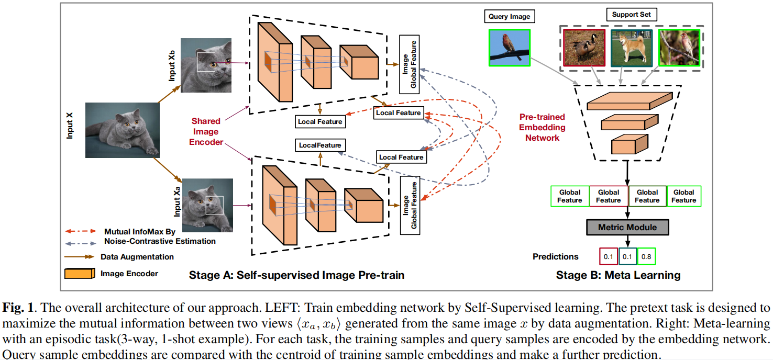
Method
Chongqing University of Technology
ATAI
Advanced Technique of Artificial Intelligence

Slide 5
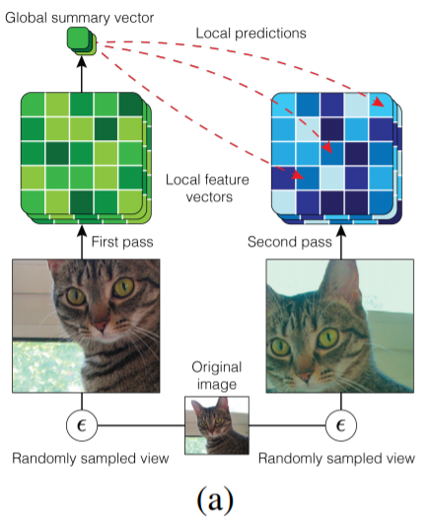
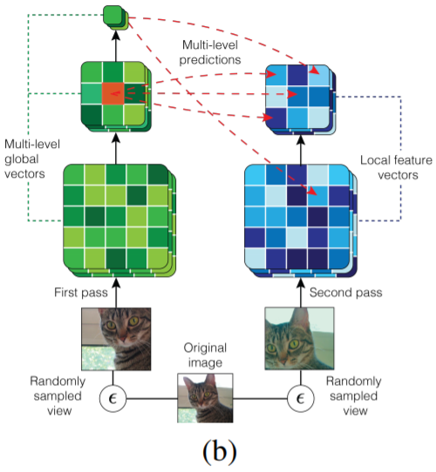
Method
Chongqing University of Technology
ATAI
Advanced Technique of Artificial Intelligence
Paper : Learning representations by maximizing mutual information across views（NeurIPS 2019）
Code:: https://github.com/Philip-Bachman/amdim-public

Slide 6
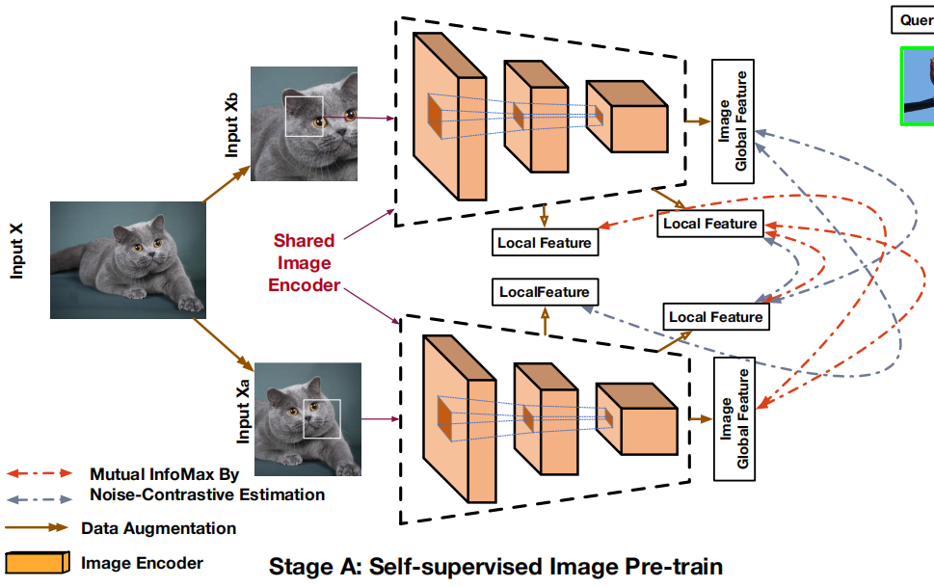
Method
Chongqing University of Technology
ATAI
Advanced Technique of Artificial Intelligence
Self-supervised learning stage：
(1)
(2)
(3)

Slide 7
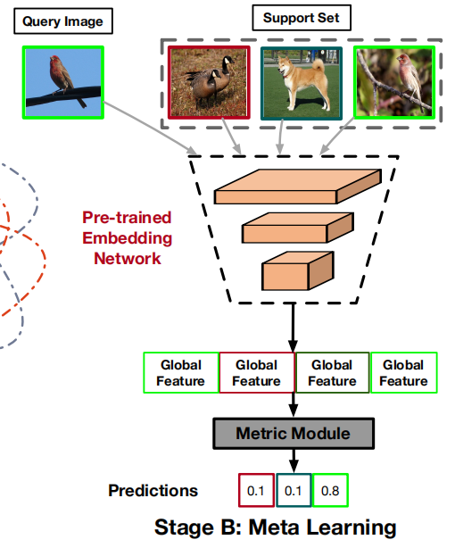
Method
Chongqing University of Technology
ATAI
Advanced Technique of Artificial Intelligence
Meta-learning stage：
(4)
(5)
(6)

Slide 8
Chongqing University of Technology
ATAI
Advanced Technique of Artificial Intelligence
Experiments
MiniImageNet dataset : It contains 60,000 images from 100 classes, and each class has 600 images.Sample images of 64 classes for training, 16 classes for validation, 20 classes for the test.
CUB-200-2011(CUB) dataset : It contains 200 classes of birds with 11788 images in total. For evaluation, we follow the split in 200 species of birds are randomly split to 100 classes for training,
50 classes for validation, and 50 classes for the test.

Slide 9
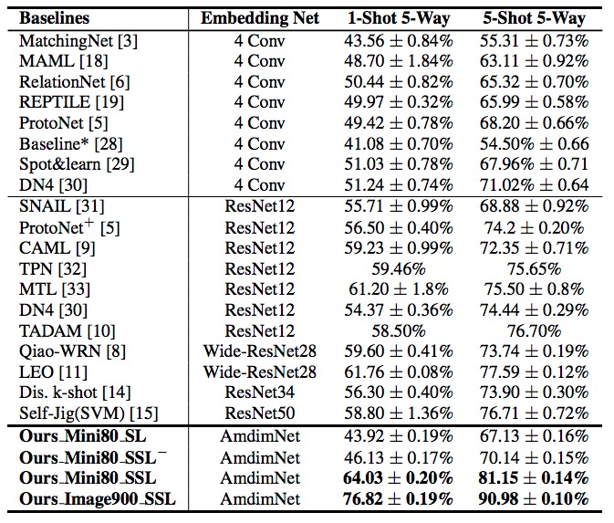
Chongqing University of Technology
ATAI
Advanced Technique of Artificial Intelligence
Experiments
Mini80-SL is supervised training using same AmdimNet by cross-entropy loss with labels.
Mini80-SSL is self-supervised trained from 48,000 images (80 classes training and validation ) without labels.
Image900-SSL is SSL trained from all images from ImageNet1K except MiniImageNet.
Table 1. Few-shot classification accuracy results on MiniImageNet. ‘—’indicates result without meta-learning.

Slide 10
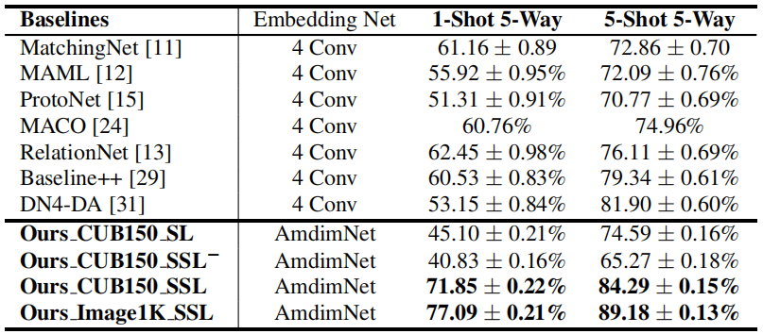
Chongqing University of Technology
ATAI
Advanced Technique of Artificial Intelligence
Experiments
CUB150-SL is the supervised trained model.
CUB150-SSL is trained by SSL from 150 classes (training and validation).
Image1K-SSL is SSL trained from all images from ImageNet1K without any label.
Table 2. Few-shot classification accuracy results on CUB dataset.‘—’indicates result without meta-learning.

Slide 11
Chongqing University of Technology
ATAI
Advanced Technique of Artificial Intelligence
Experiments
Table 3. Cross-domain few-shot learning tests on four datasets.

Slide 12
Chongqing University of Technology
ATAI
Advanced Technique of Artificial Intelligence
Conclusion
In a short conclusion, the proposed method first applies an SSL way to pre-train a large scale embedding network in stage one, followed by a detailed fine-tuning in stage two with a meta-learning scheme.
After fine-tuning by a meta-learning process, the performance of the proposed method can significantly outperform all baselines based on the quantitative results using two common few-shot classification datasets and a cross-domain few-shot learning set-up.

Slide 13
Chongqing University of Technology
ATAI
Advanced Technique of Artificial Intelligence
Chongqing University of Technology
Thank you!

